Slide 1

DEPARTMENT OF COMPUTER SCIENCE & ENGINEERING
SCHOOL OF COMPUTING
1156CS701- MAJOR PROJECT
WINTER SEMESTER 22-23
INTERNSHIP THROUGH DIND
Nandha Infotech
REVIEW - II
“WEB-BASED ONLINE DISCUSSION FORUM APPLICATION”
SUPERVISED BY
Dr.Angeline Lydia
Associate Professor
PRESENTED BY
S.MANOJH KUMAR (VTU12596 )(19UECS0586)
E.SHALINI (VTU11514)(19UECS0901)
M.HARINI NESAPRIYA (VTU13669)(19UECS0365)

Slide 2
INDUSTRY DETAILS
Industry Name/Institute Name: Nandha Infotech
Duration of Internship (From Date – To Date): (Jan 11-Apr 23)
Duration of Internship in Months: 4months
Industry Guide Name: R.D.Shiju
Industry Guide Mobile No: 9487184325
Industry Guide Mail ID: shiju@nandhainfotech.com
Industry Address: 89/99 NGN St, Siddhapudur, New Siddhapudur, Tamil Nadu 641044
Project Completion Status as of now(Completed/In-Progress):
In-Progress

Slide 3
AGENDA
ABSTRACT
OBJECTIVE
INTRODUCTION
LITERATURE REVIEW (SOFT COPY OF PAPERS TO BE LINKED AS HYPERLINK)
DESIGN AND METHODOLOGIES
IMPLEMENTATION
TESTING
INPUT AND OUTPUT
INCLUDE DEMO VIDEO-1 (Till REVEW-1)
INCLUDE DEMO VIDEO-2(Complete Implementation of Project)
CONCLUSION
WEB REFERENCES LINK(TILL REVIEW DATE ALL LINKS TO BE INCLUDED DAY WISE)
INCLUDE YOUR 2 PHOTOS OF YOUR INDUSTRY WORKING ENVIRONMENT
PLAGIARISM REPORT OF PPT
REFERENCES

Slide 4
ABSTRACT
Online group discussion forum application has been around for several years.It is a web application where students can post their doubts and they can also clarify their doubts by other users and also user can view the previous discussion taken place on that day.It is difficult to note down all the problems manually so by using online discussion forum application they can clarify their doubts easily and faster.

Slide 5
OBJECTIVES
Aim of the Project:
To design an web based online disscusion forum application which helps the students to clear their doubts.
Scope of the Project:
The scope of the project is to create an online forum web application where people can hold their conversations in the form of posted messages. They differ from chat rooms in that messages are often longer than one line of text, and are at least temporarily archived. Also, depending on the access level of a user, a posted message might need to be approved by a moderator before it becomes publicly visible.

Slide 6
INTRODUCTION
The project named “WEB-BASED ONLINE DISCUSSION FORUM APPLICATION” by creating account in this application the students can share their ideas and they can also make decission on various topics. Its technically a discussion form where users(students) can clear their doubts by posting questions and also they can learn other topics by reading live conversation or by reading the previous conversations. Eventhough there are many forum applications are already there like brainly, quara etc. Each applications has their own demerits for students to use. So,we creating the application which will make more comfortable for the students to use.

Slide 7
LITERATURE REVIEW
Southern New Hampshire University. (2017). Research guides: asynchronous discussion resource guide: providing feedback. Libguides.snhu.edu. Retrieved 10 October 2017, from http://libguides.snhu.edu/c.php?g=92441&p=596049
Bechmann, J., & Weber, P. (2016). Cognitive presence in collaborative learning: Assessing and improving critical thinking in online discussion forums. Interactive Technology and Smart Education, 13(1), 52-70.
Research found that asynchronous online discussion forums are better to synchronous face-to-face discussions as they encourage critical thinking and knowledge co-construction because of the ability to react (Afy, 2015; Beckmann & Weber, 2016; Klisc, 2015). Using Atlas.ti, a qualitative software for data organization, more than 200 discussion threads were analysed and concluded that ODF encouraged reection in problem-solving situations within a collaborative environment. She founds that the users were able to connect to real life problems and asks questions that were related to real life situations .

Slide 8
Xiaoling, L. (2018). The Effectiveness of Online Discussion Forums and Recommendations for Chinese Higher Education. A Project Submitted in Partial Fulfillment of the Requirements for the Degree of Master of Education, Department of Curriculum and Instruction, University of Victoria.
Zuheir, K; Hamid, N; and Kyungbin, K. (2017). Types of Interaction in Online Discussion Forums: A Case Study. Journal of Educational Issues,3 (1): 155-159.
Online discussion forums play an important role in tertiary education and many researchers have studied the effectiveness of these forums. However, there are few studies explicitly concluding that online discussion forums are actually effective in promoting students’ academic or non-academic learning. What exists in the literature are a series of claims about online learning, therefore, a critical examination of these claims of the effectiveness of online learning forums is necessary. Part of existing literature claims that students will gain knowledge when using online discussion forums. Evidence for this claim can be found through their relatively higher grades or students’ self-evaluation after using online discussion forums. Some published literature claims that online discussion forum encourage the development of students’ analytic thinking through students’ high level of participation in these forums.

Slide 9
DESIGN AND METHODOLOGIES
MODULE 1
MODULE 2
MODULE 3

Slide 10
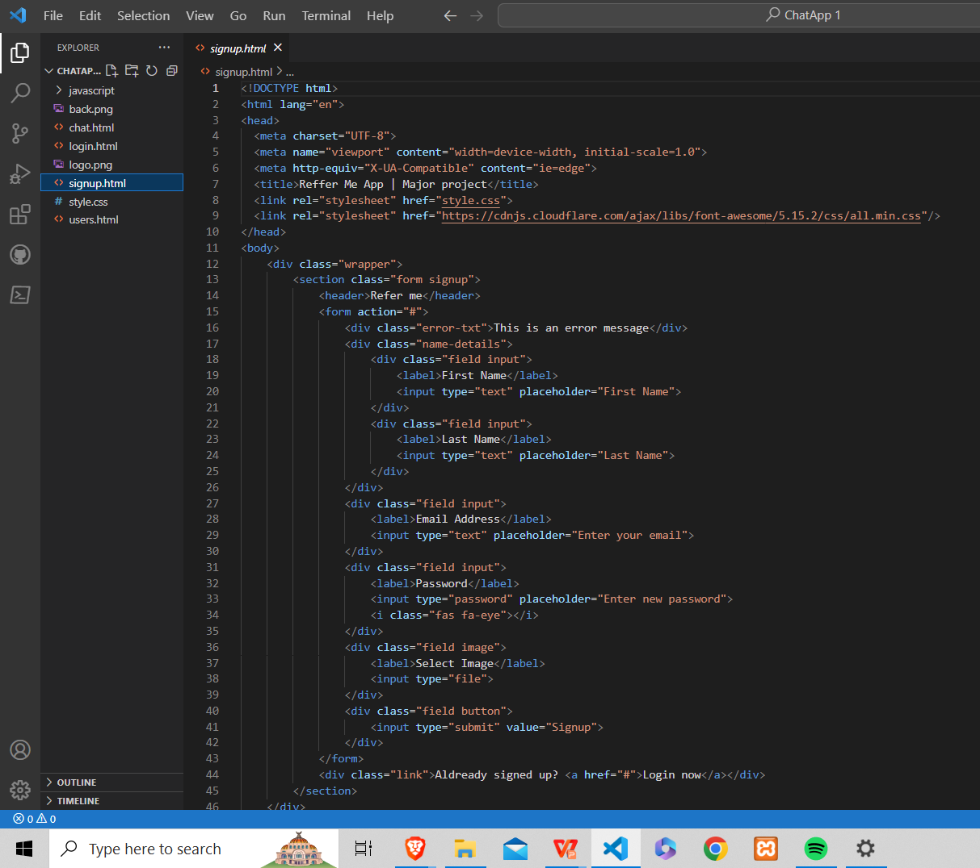
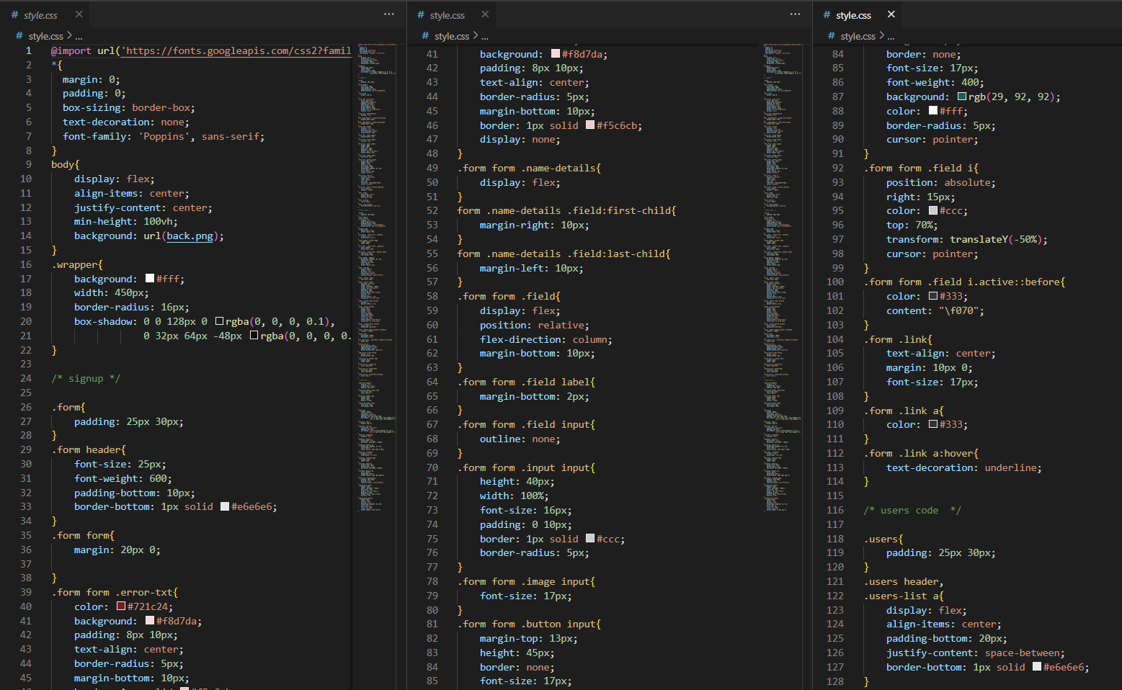
MODULE:1
Creating Front-End for the forum application using HTML and CSS
HTML
CSS

Slide 11
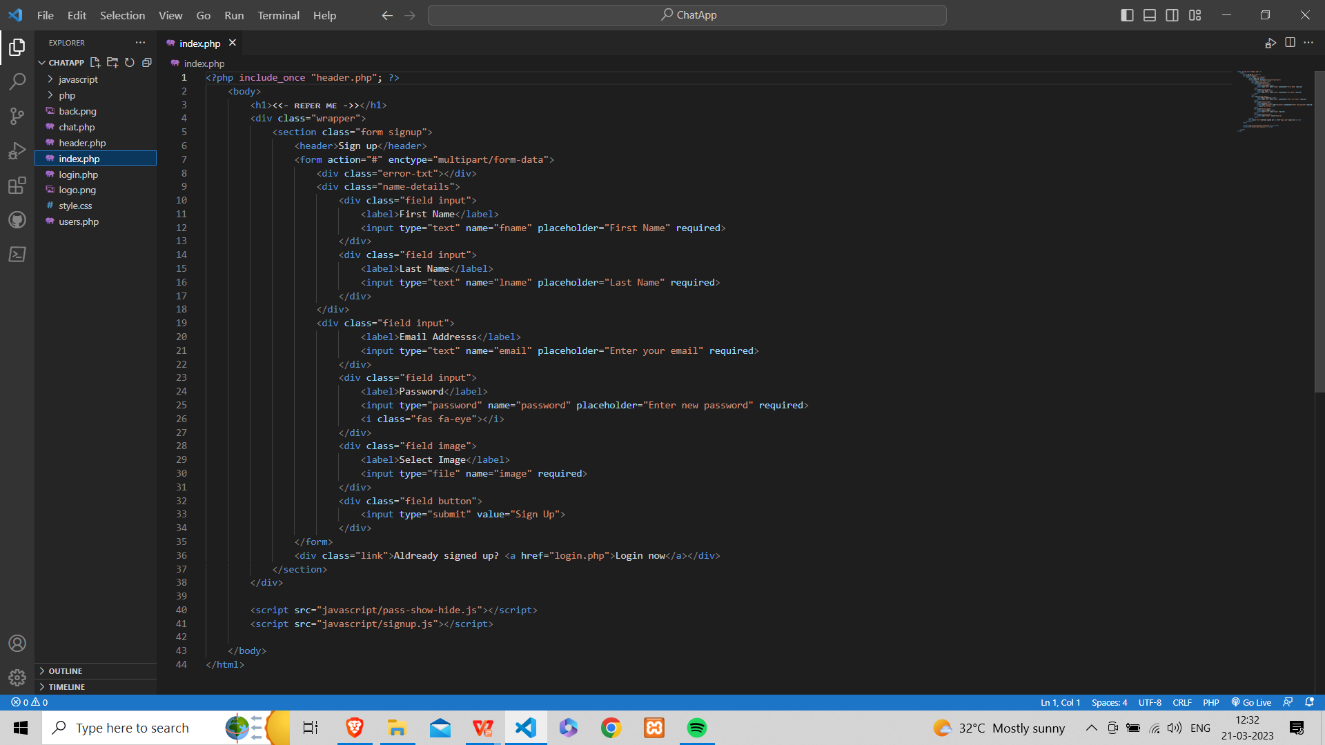
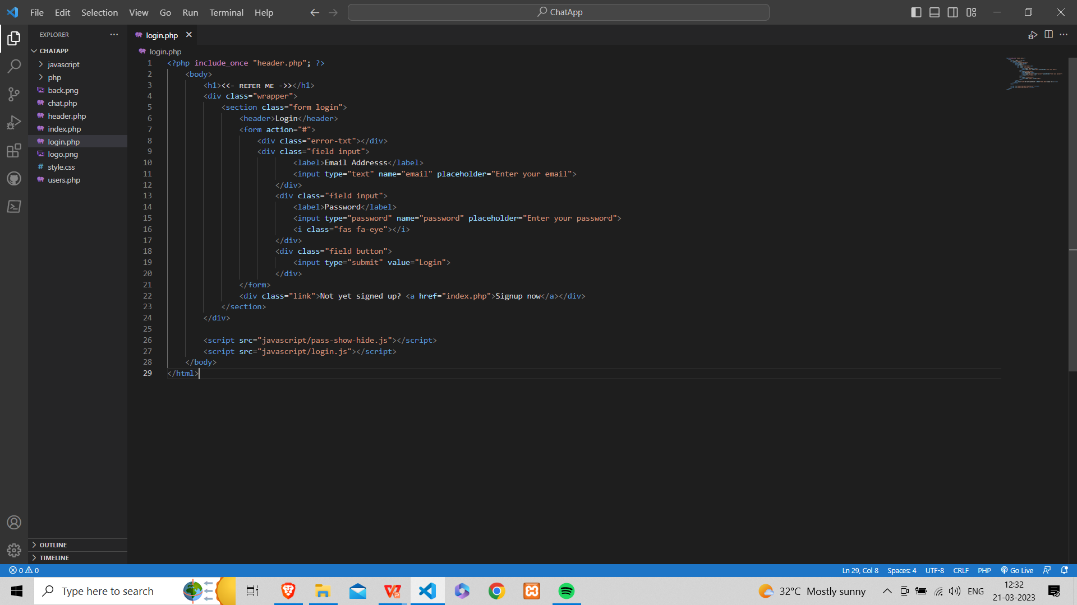
MODULE 2
After completion of the front end application convert all HTML code to php for the database(phpmyadmin)

Slide 12
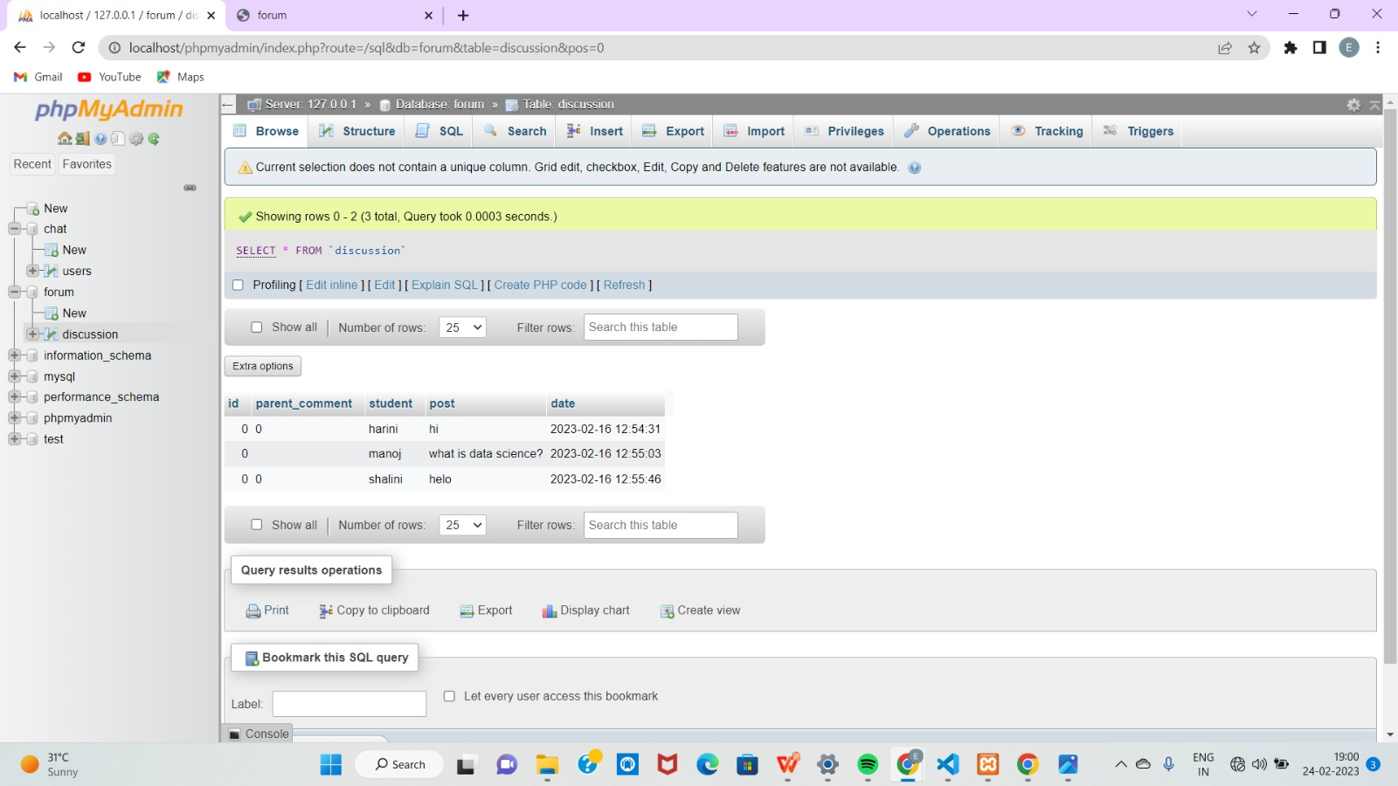
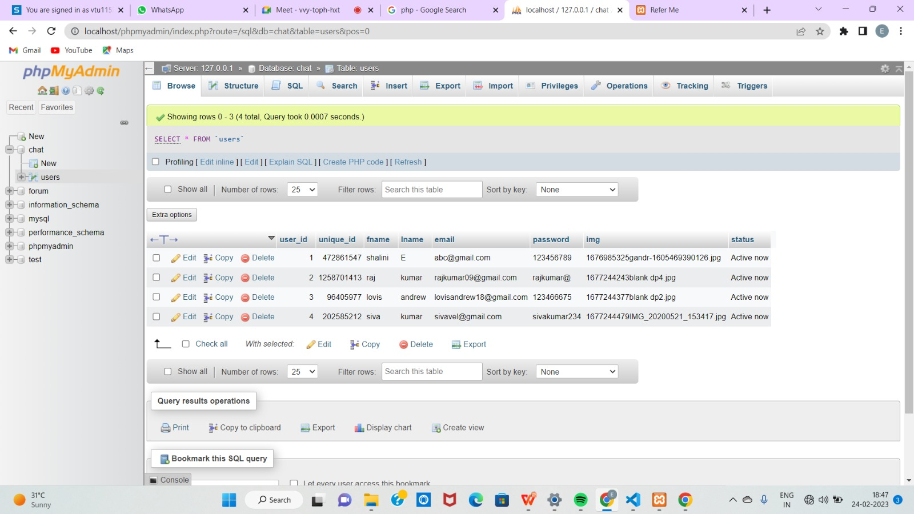
MODULE 3
After connecting to the local host the users data has been stored in database

Slide 13
IMPLEMENTATION
ARCHITECTURE DIAGRAM
DATA FLOW DIAGRAM
ER DIAGRAM
SEQUENCE DIAGRAM
COLLABORATION DIAGRAM

Slide 14
ARCHITECTURE DIAGRAM
User BFF
Login | Group Discussion | Chat Box
phpMyAdmin
MariaDB Server
phpMyAdmin(For app database)
User collection

Slide 15
DATA FLOW DIAGRAM
User is forwarded to the main page of the application
User clicks the login button to enter into the application
process
Log in
User can post their queries
Application database
User can solve the queries
Group discussion
content moderation
User can chat with other individual user to clarify their doubts
Chat box

Slide 16
ER DIAGRAM
Email address
user
Password
User Name
Check
Sign up
Email
Login
password
Success
User image
Try again
Disscuss
Main Page
Post
Group discussion
Chat box
Personal discussion
Reply
Log out

Slide 17
SEQUENCE DIAGRAM
Admin
Login Success
Forum managment
Registration management
Chat app management
Add/Edit Forum
Add/Edit registration
Add/Edit chats
Login to page
Manage forum
Save/update forum
List/Delete registration
Manage text area details
Manage Chats
Save/update Chats

Slide 18
COLLABORATION DIAGRAM
Login()
Chat app
Home Page
Forum
Open conversation
Personal conversation
Display the conversion taken place
Posting/Solving queries
User(Student)
Log out
Processed

Slide 19
TESTING
UNIT TESTING
INTEGRATION TESTING
FUNCTIONAL TESTING
WHITE BOX TESTING
BLACK BOX TESTING

Slide 20
TESTING
UNIT TESTING
It is a method of testing a software by taking small testable pieces of code called units. Unit testing can be done to verify if every part of the code is working as intended. Unit testing also ensures that the code still works properly after making changs thereby ensuring code stability.
INTEGRATION TESTING
It is done to check for irregularities present between the interactions between the components of the software.The goal is to take the components from the unit tested modules and use them to create a program structure. It occurs when a set of components is combined to achieve a result.

Slide 21
FUNCTIONAL TESTING
Every time a new module is added to the default program, the structure of the program is altered. This sort of testing ensures that the entire component is working properly even after it has been added to the entire application.
WHITE BOX TESTING
It is a software testing technique that involves testing the internal structure and working of a software application. The tester has access to the source code and uses his knowledge to design the test cases that can verify the correctness of the software.

Slide 22
BLACK BOX TETING
It is a software testing method in which the functionalities of software applications are tested without having knowledge of internal code structure, implementation details and internal paths.

Slide 23
INPUT
SCREENSHOTS
index.php
login.php

Slide 24
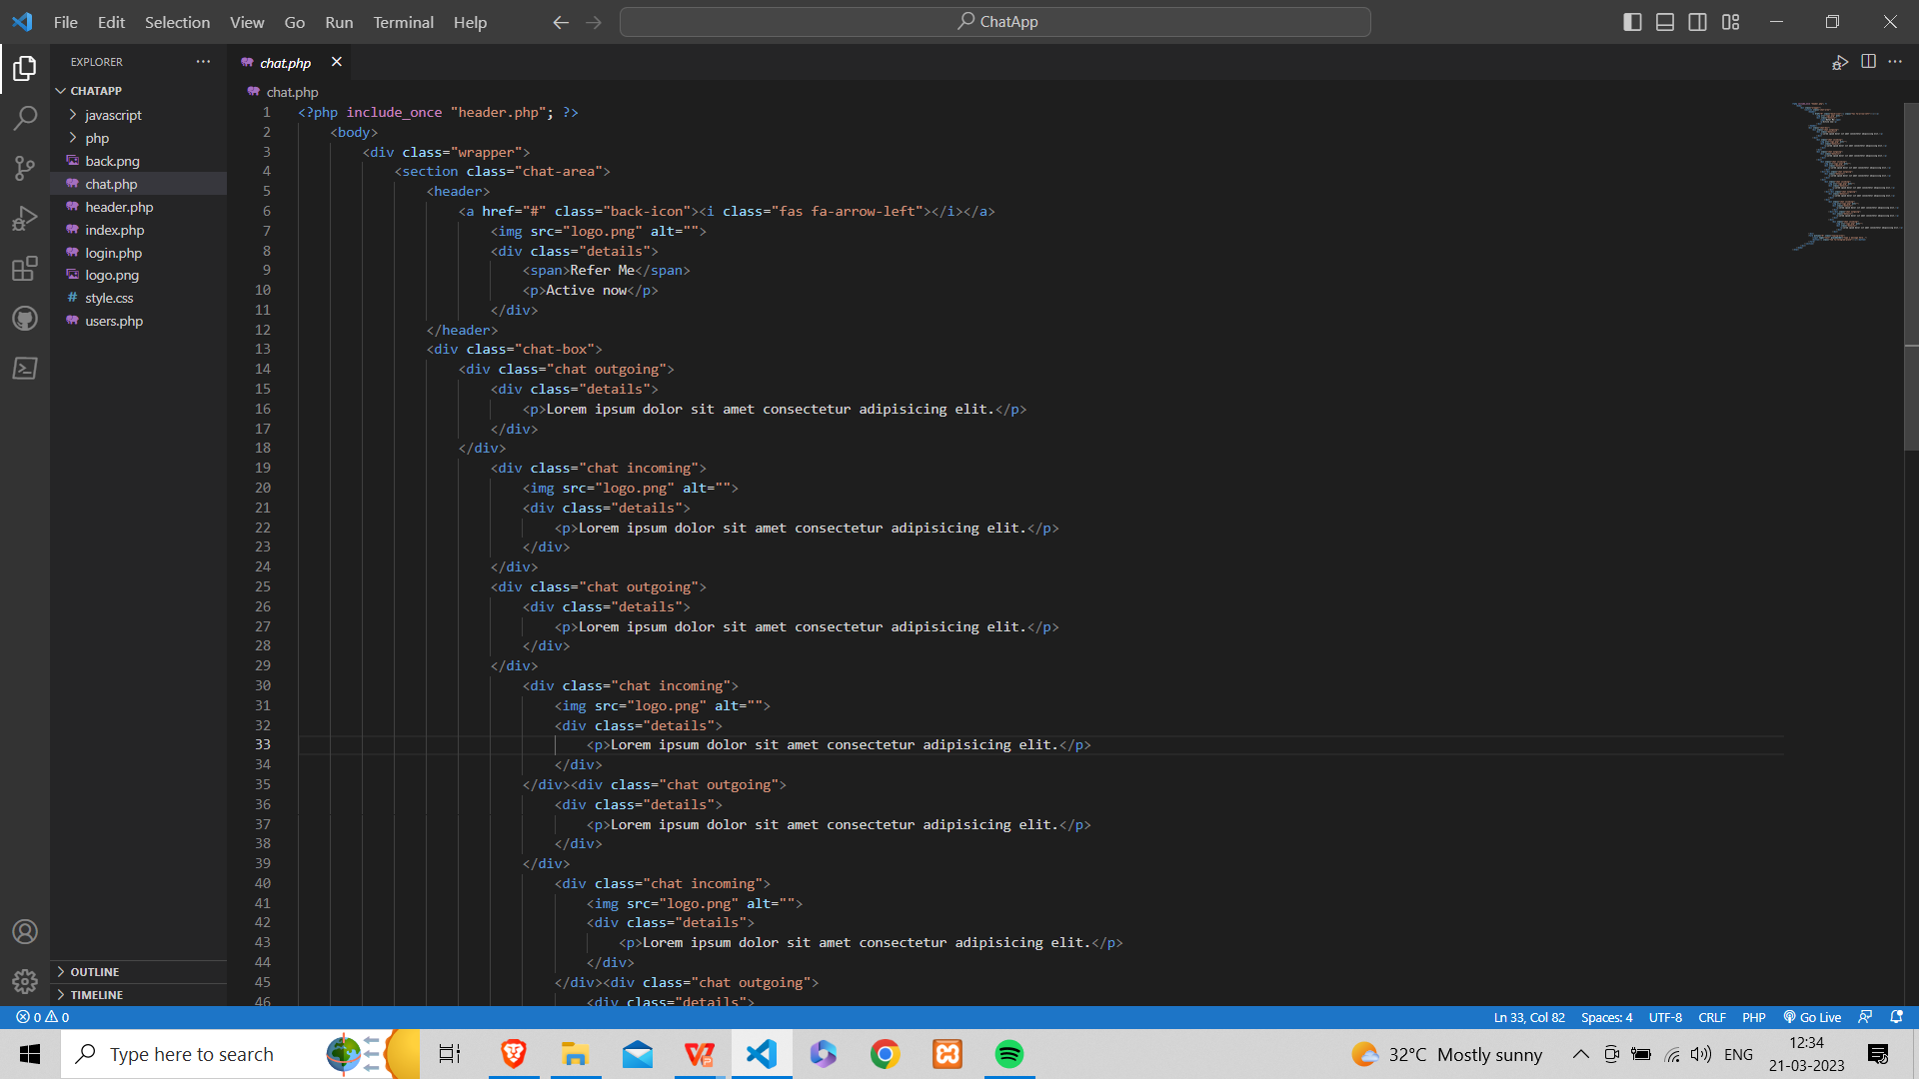
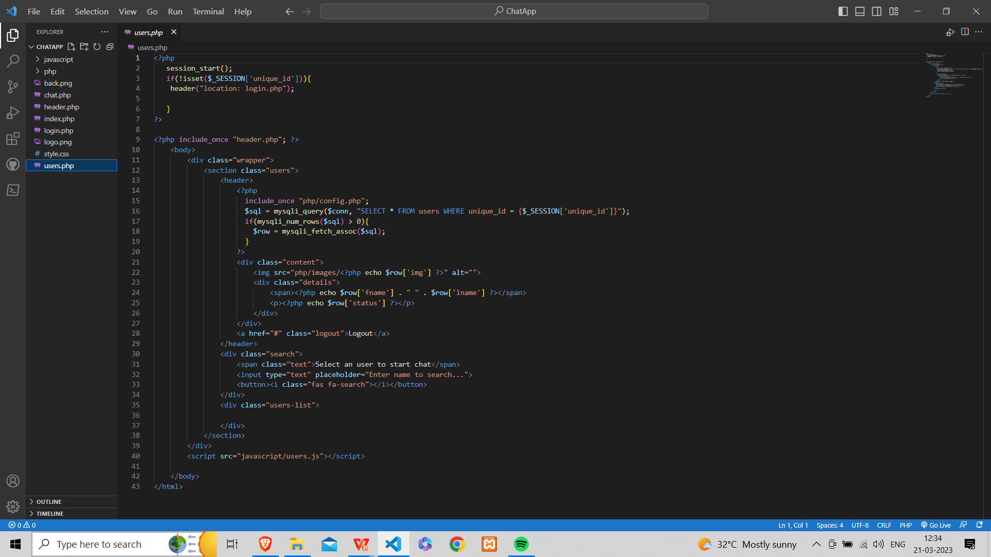
Chat.php
Users.php

Slide 25
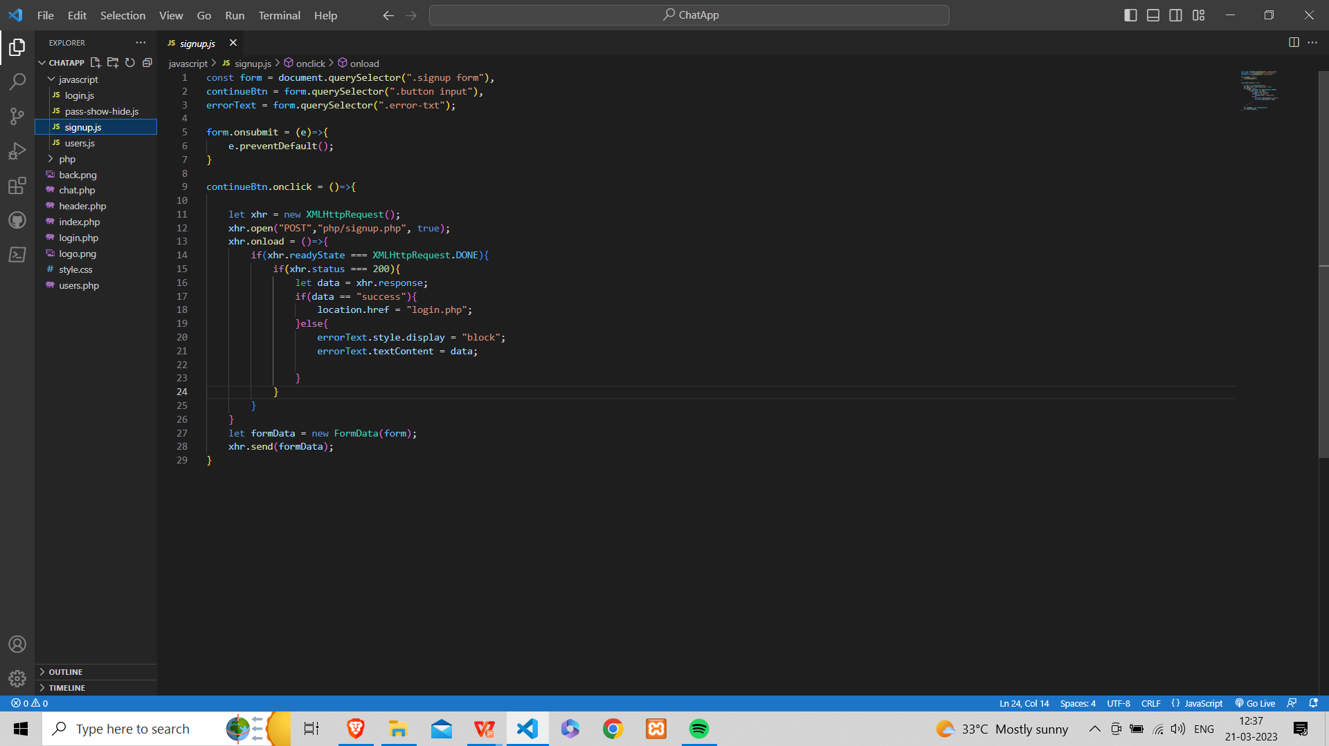
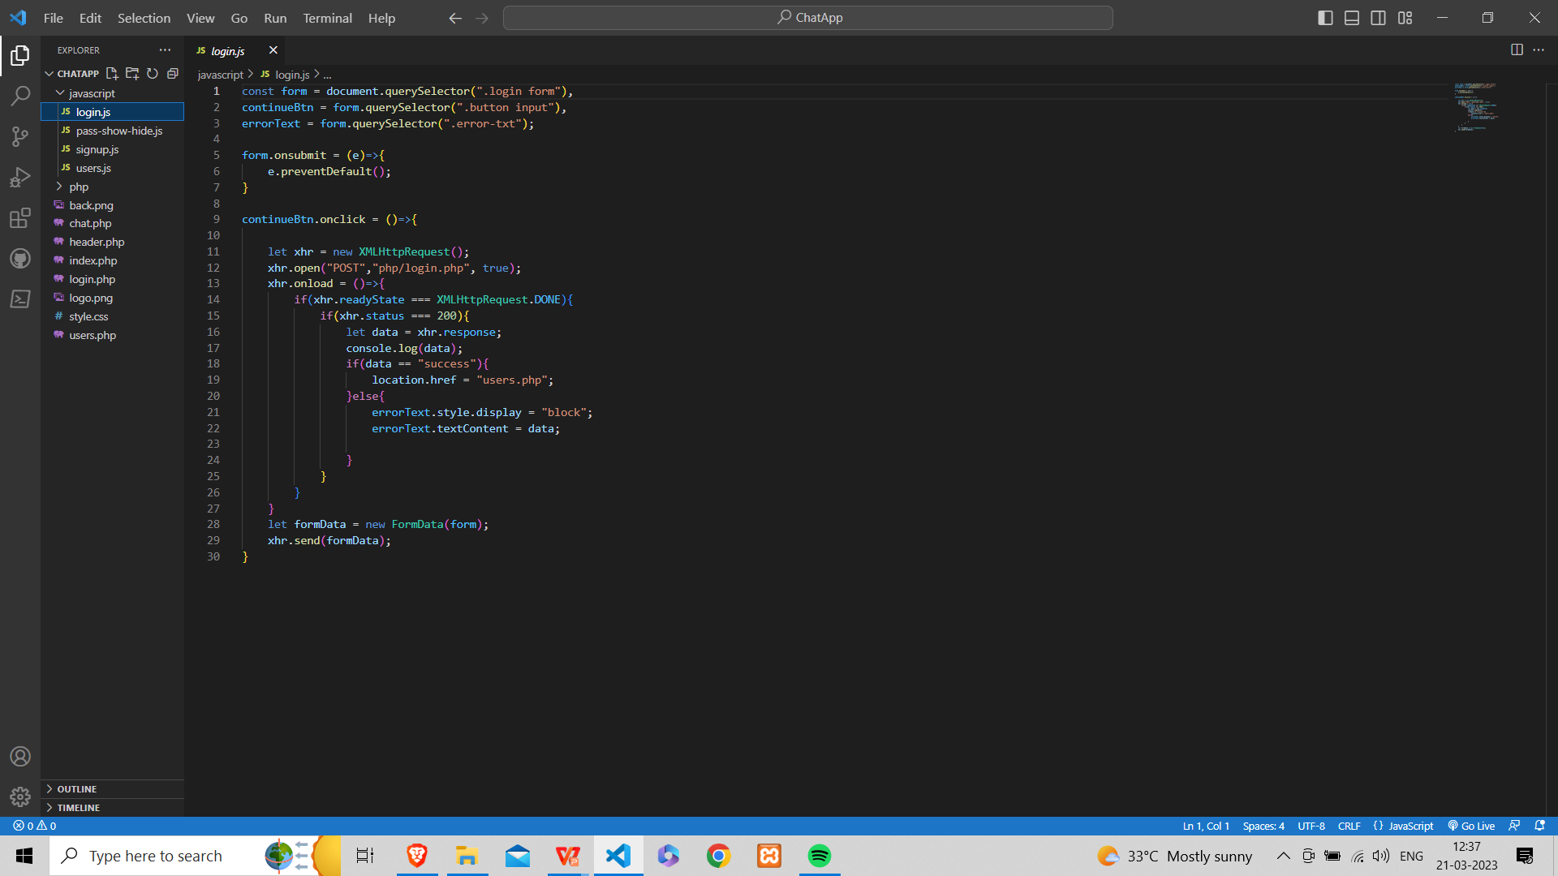
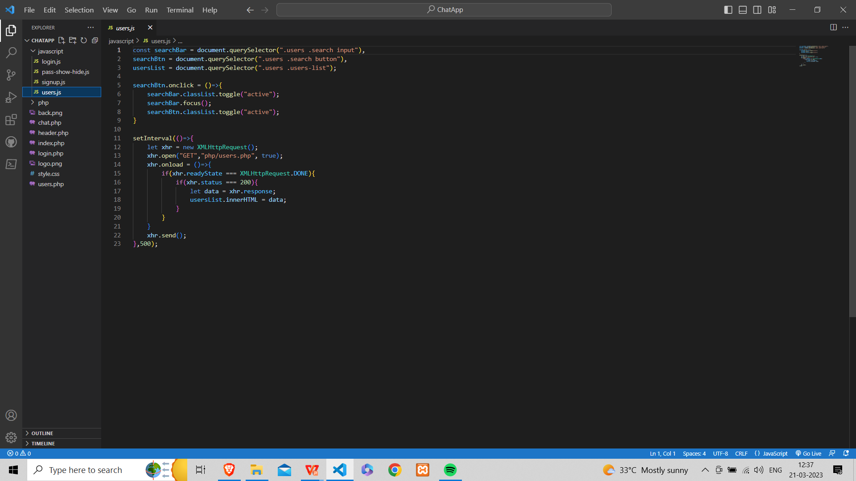
Signup.js
login.js
Users.js

Slide 26
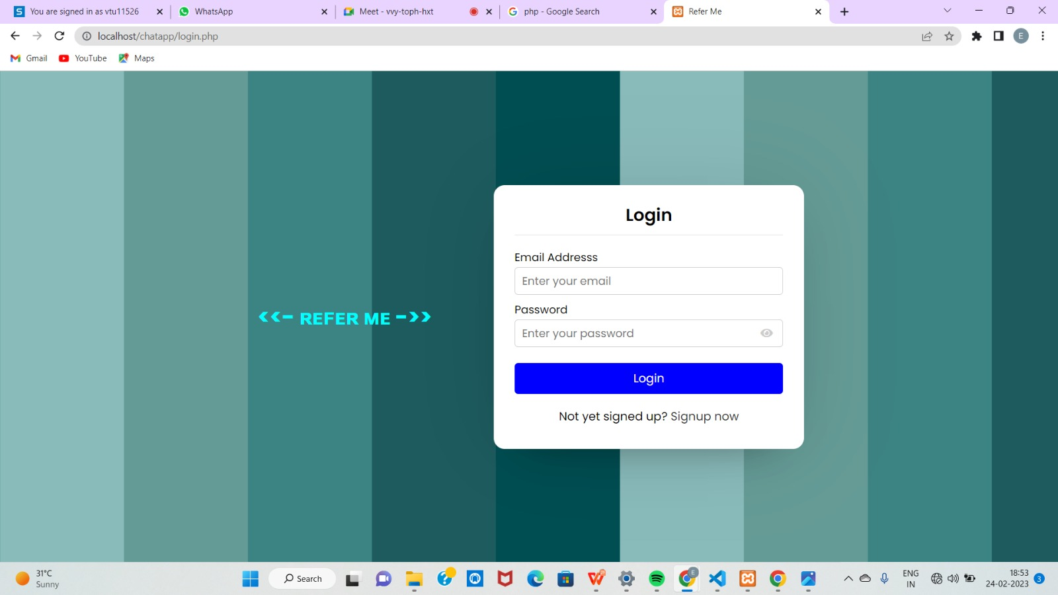
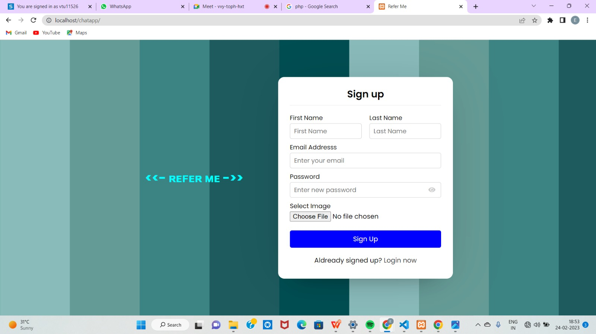
INPUT:
SCREENSHOTS :
Login page
Signup page

Slide 27
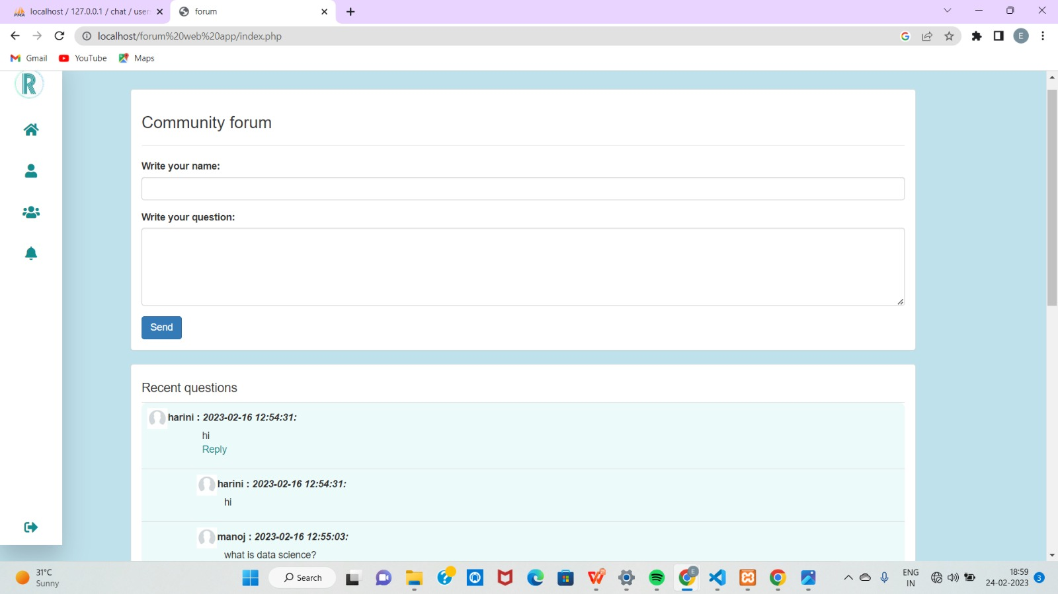
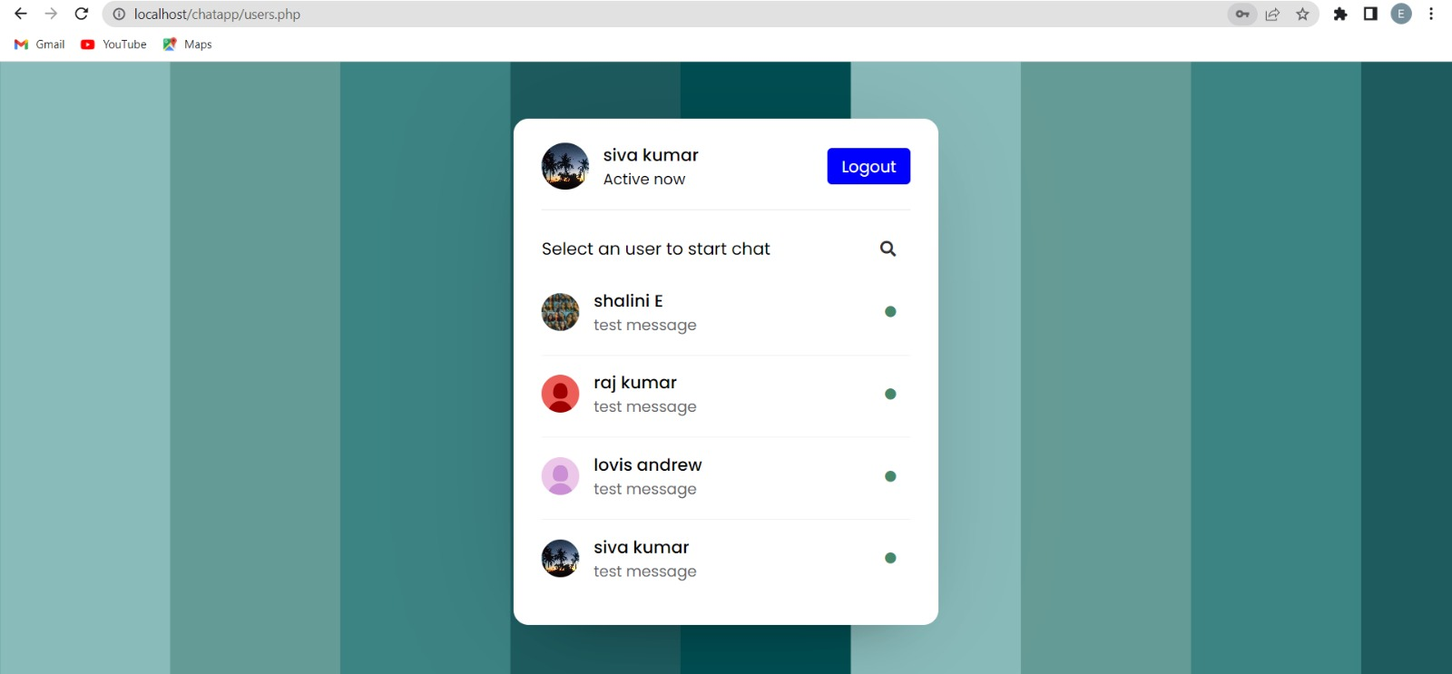
Forum page
Available users

Slide 28
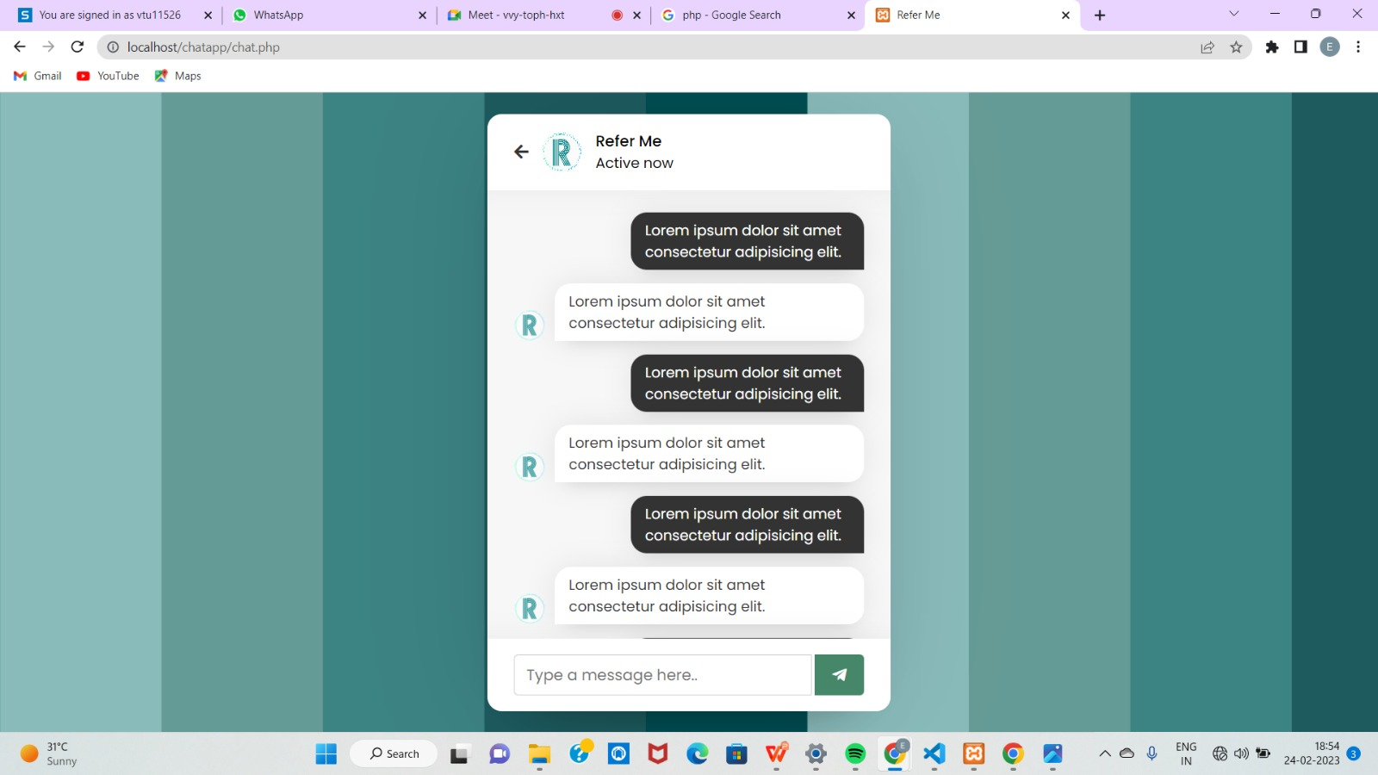
Chat box

Slide 29
CONCLUSION
The Web based online disscusion forum application is used to serve as a channel through which the students can share their opinions and can also clarify their doubts by viewing the previous conversation based on the topic. The forum application also ensures the participation of the students in various activities and events to create a healthy environment.

Slide 30
Web references/video links
https://www.researchgate.net/publication/326331303_Cognitive_presence_in_virtual_collaborative_learning_Assessing_and_improving_critical_thinking_in_online_discussion_forums
https://www.sciencedirect.com/science/article/pii/S1096751621000269
https://files.eric.ed.gov/fulltext/EJ1057329.pdf

Slide 31
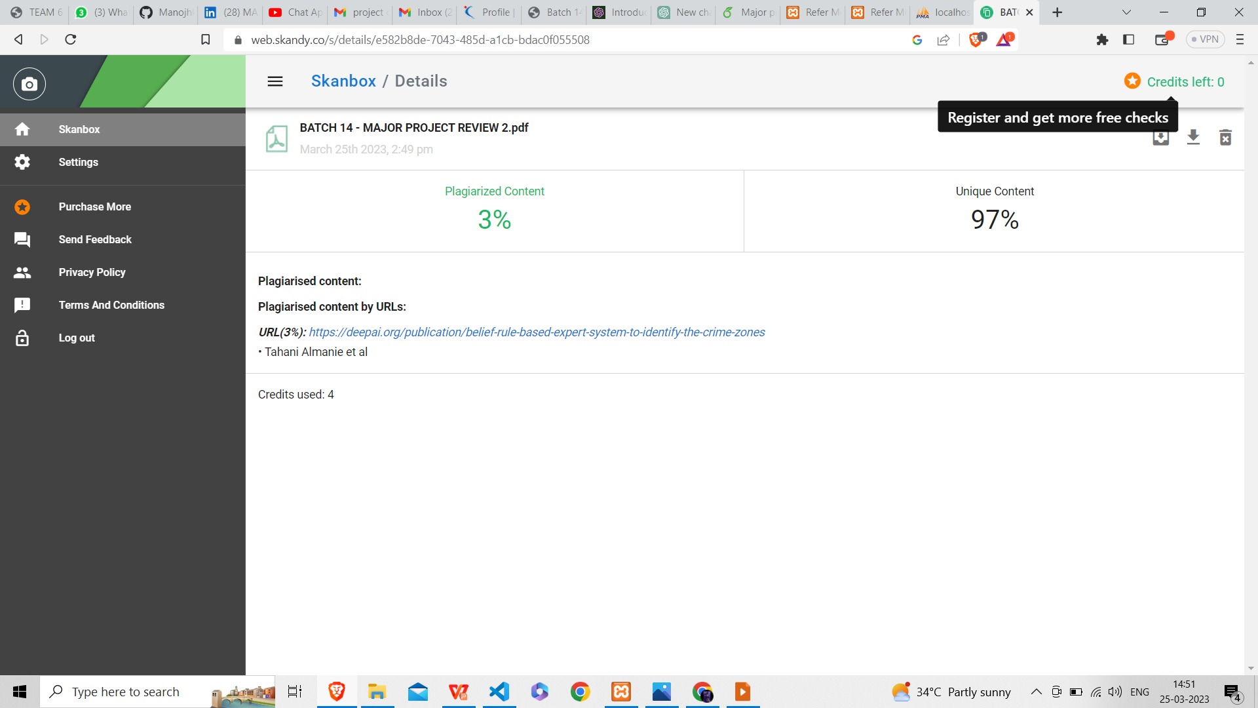
Plagiarism Report of PPT

Slide 32
REFERENCES(as per IEEE format only)
Muhammad, S.K; Irfanullah, K; Siraj, -D; Hafiz ,M.I; Rafid,K and Rahimullah, J. (2015). The Impacts of ICT on the students’ Performance: A Review of Access to Information. Research on Humanities and Social Sciences, 5 (1): 85-94.
Salako, E. A; Solomon, A.A; and Muhammed, B. A. (2015).Perception of Students on Computer Utilization and Academic Performance in the North-Central Geopolitical Zone of Nigeria. I.J. Modern Education and Computer Science, 4: 53-60.
Mashael, N.A; Heba, M; Ayham, F, and Waleed, A. (2015). Web 2.0 in Education: the Impact of Discussion Board on Student Performance and Satisfaction. Turkish Online Journal of Educational Technology, 14 (2): 247-258.
Bechmann, J., & Weber, P. (2016). Cognitive presence in collaborative learning: Assessing and improving critical thinking in online discussion forums. Interactive Technology and Smart Education, 13(1), 52-70.
Awofeso, N., Hassan, M., & Hamidi, S. (2016). Individual and collaborative technologymediated learning using question & answer online discussion forums--perceptions of public health learners in Dubai, UAE. Open Learning, 31(1), 54-63.

Slide 33
Stoerger, S., & Krieger, D. (2016). Transforming a large-lecture course into an active, engaging, and collaborative learning environment. Education for Information, 32(1), 11-26. doi:10.3233/EFI-150967`
Southern New Hampshire University. (2017). Research guides: asynchronous discussion resource guide: providing feedback. Libguides.snhu.edu. Retrieved 10 October 2017, from http://libguides.snhu.edu/c.php?g=92441&p=596049
Zuheir, K; Hamid, N; and Kyungbin, K. (2017). Types of Interaction in Online Discussion Forums: A Case Study. Journal of Educational Issues,3 (1): 155-159.
Xiaoling, L. (2018). The Effectiveness of Online Discussion Forums and Recommendations for Chinese Higher Education. A Project Submitted in Partial Fulfillment of the Requirements for the Degree of Master of Education, Department of Curriculum and Instruction, University of Victoria.
Jeff, K (2019). 5 Online Discussion Tools Fuel Student Engagement. Retrieved from online via:www.Commonsense.org/education/articles/5-online-discussiontools-fuel-student-engagement.

